Slide 1
Intermediate SQL Unit-2,Part-2 Faculty: A.Sirisha

Slide 2
Outline
Join Expressions
Views
Integrity Constraints
Index Definition in SQL
Notes:
1

Slide 3
Joined Relations
Join operations take two relations and return as a result another relation.
A join operation is a Cartesian product which requires that tuples in the two relations match (under some condition). It also specifies the attributes that are present in the result of the join .
The join operations are typically used as subquery expressions in the from clause
Three types of joins:
Natural join
Inner join
Outer join

Slide 4
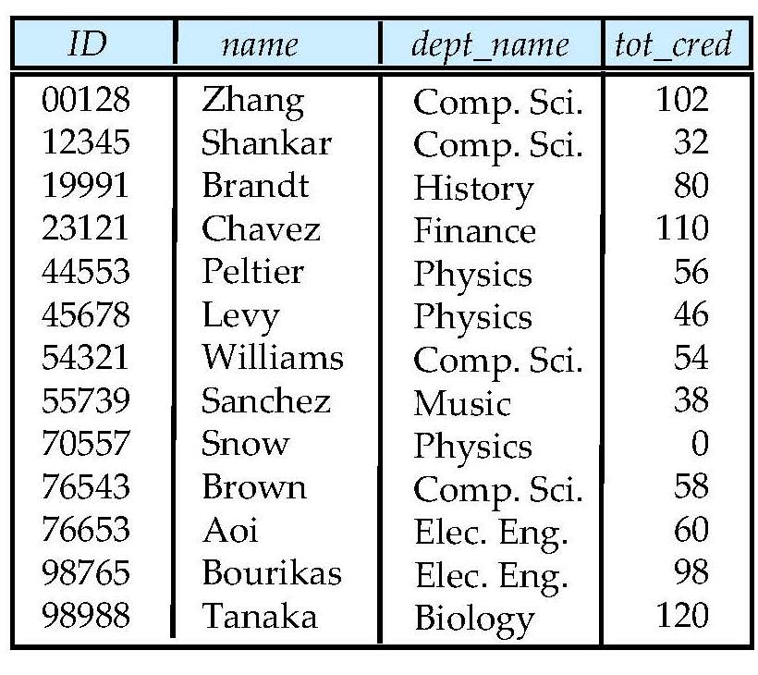
Student Relation

Slide 5
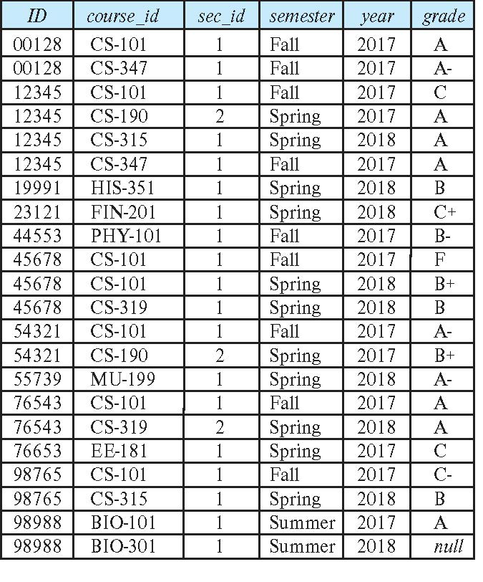
Takes Relation

Slide 6
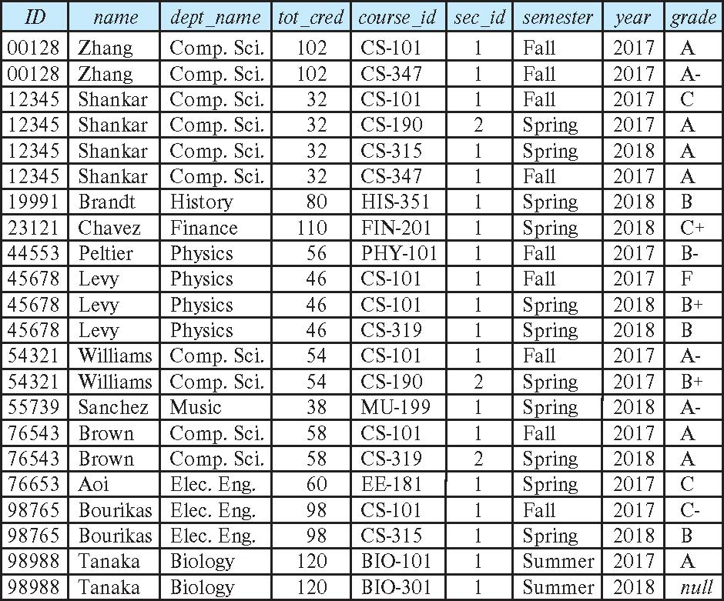
student natural join takes

Slide 7
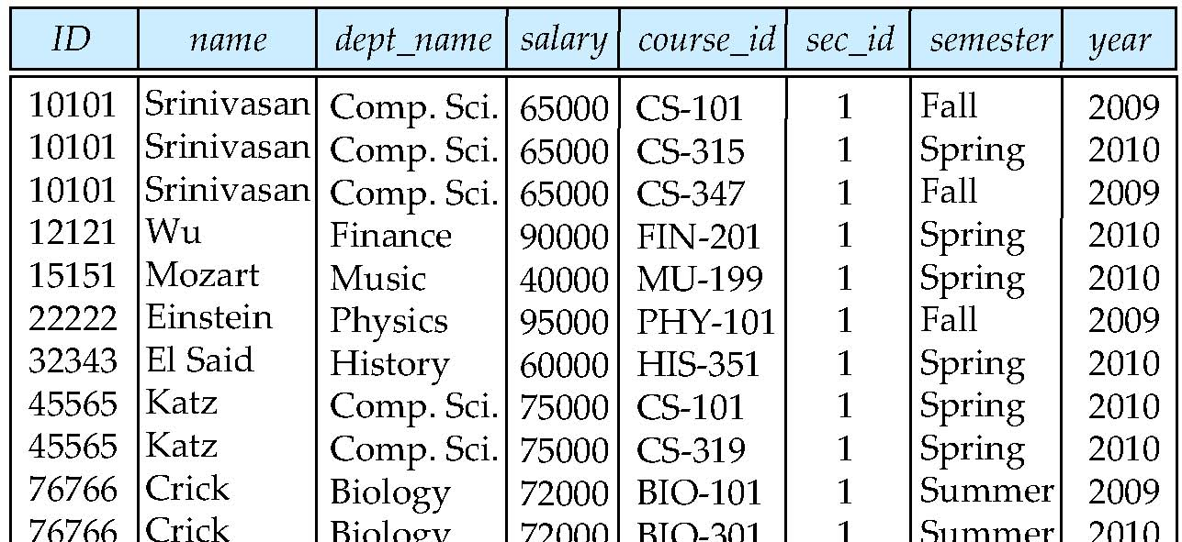
Natural Join
Natural join matches tuples with the same values for all common attributes, and retains only one copy of each common column
select * from instructor natural join teaches;

Slide 8
Natural Join in SQL
List the names of instructors along with the course ID of the courses that they taught
select name, course_id from instructor, teaches where instructor.ID = teaches.ID;
Same query in SQL with “natural join” construct
select name, course_id from instructor natural join teaches;
The from clause can have multiple relations combined using natural join:
select A₁, A₂, … A_{n} from r₁ natural join r₂ natural join .. natural join r_{n} where P ;

Slide 9
Dangerous in Natural Join
Beware of unrelated attributes with same name which get equated incorrectly
Example -- List the names of students along with the titles of courses that they have taken
Incorrect version
select name, title from student natural join takes natural join course;
This query omits all (student name, course title) pairs where the student takes a course in a department other than the student's own department.
The correct version (below), correctly outputs such pairs.
Correct version
select name, title from student natural join takes, course where takes.course_id = course.course_id;

Slide 10
Natural Join with Using Clause
To avoid the danger of equating attributes erroneously, we can use the “using” construct that allows us to specify exactly which columns should be equated.
Another correct version of previous Query example
select name, title from (student natural join takes) join course using (course_id)

Slide 11
Join Condition
The on condition allows a general predicate over the relations being joined
This predicate is written like a where clause predicate except for the use of the keyword on
Query example
select * from student join takes on student_ID = takes_ID
The on condition above specifies that a tuple from student matches a tuple from takes if their ID values are equal.
Equivalent to:
select * from student , takes where student_ID = takes_ID

Slide 12
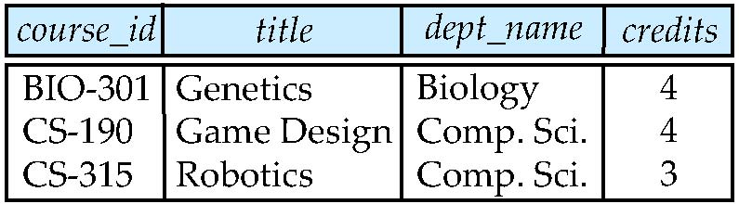
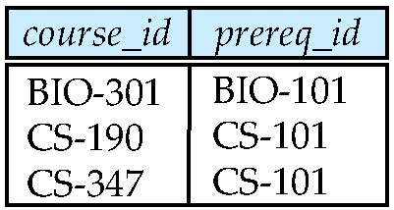
Join operations – Example
Relation course
Relation prereq
Observe that
course information is missing CS-347
prereq information is missing CS-315

Slide 13
Outer Join
An extension of the join operation that avoids loss of information.
Computes the join and then adds tuples form one relation that does not match tuples in the other relation to the result of the join.
Uses null values.
Three forms of outer join:
left outer join
right outer join
full outer join

Slide 14
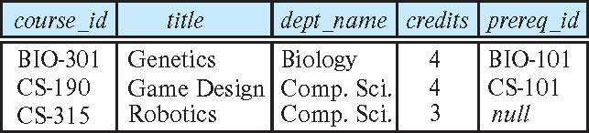
Left Outer Join
course natural left outer join prereq
In relational algebra: course ⟕ prereq

Slide 15
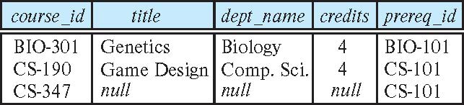
Right Outer Join
course natural right outer join prereq
In relational algebra: course ⟖ prereq

Slide 16
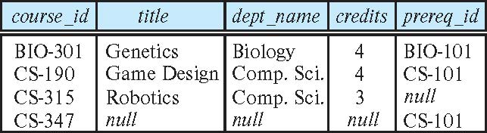
Full Outer Join
course natural full outer join prereq
In relational algebra: course ⟗ prereq

Slide 17
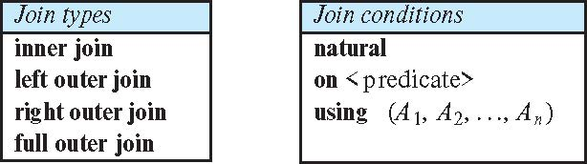
Join Types and Conditions
Join operations take two relations and return as a result another relation.
Join condition – defines which tuples in the two relations match. and what attributes are present in the result of the join.
Join type – defines how tuples in each relation that do not match any tuple in the other relation (based on the join condition) are treated.

Slide 18
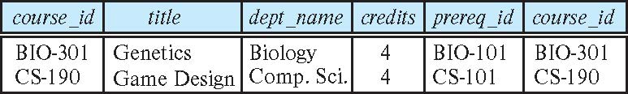
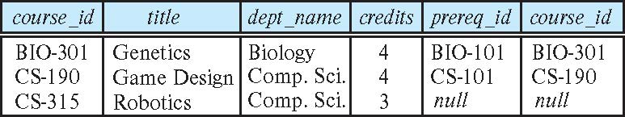
Joined Relations – Examples
course inner join prereq on course.course_id = prereq.course_id
What is the difference between the above, and a natural join?
course left outer join prereq on course.course_id = prereq.course_id

Slide 19
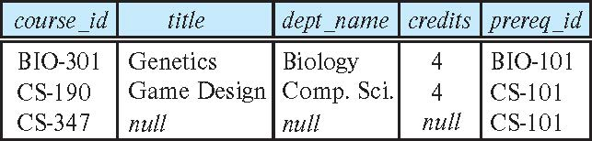
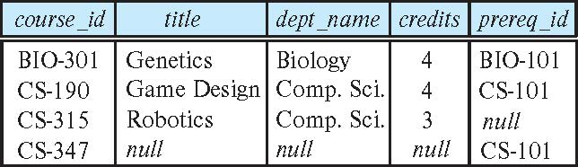
Joined Relations – Examples
course natural right outer join prereq
course full outer join prereq using (course_id)

Slide 20
Views
In some cases, it is not desirable for all users to see the entire logical model (that is, all the actual relations stored in the database.)
Consider a person who needs to know an instructors name and department, but not the salary. This person should see a relation described, in SQL, by select ID, name, dept_name from instructor
A view provides a mechanism to hide certain data from the view of certain users.
Any relation that is not of the conceptual model but is made visible to a user as a “virtual relation” is called a view.

Slide 21
View Definition
A view is defined using the create view statement which has the form
create view v as < query expression >
where <query expression> is any legal SQL expression.
The view name is represented by v.
Once a view is defined, the view name can be used to refer to the virtual relation that the view generates.
View definition is not the same as creating a new relation by evaluating the query expression
Rather, a view definition causes the saving of an expression; the expression is substituted into queries which use the view.

Slide 22
View Definition and Use
A view of instructors without their salary create view faculty as select ID, name, dept_name from instructor
Find all instructors in the Biology department select name from faculty where dept_name = ‘Biology’
Create a view of department salary totals create view departments_total_salary(dept_name, total_salary) as select dept_name, sum (salary) from instructor group by dept_name;

Slide 23
Views Defined Using Other Views
One view may be used in the expression defining another view
A view relation v₁ is said to depend directly on a view relation v₂ if v₂ is used in the expression defining v₁
A view relation v₁ is said to depend on view relation v₂ if either v₁ depends directly to v₂ or there is a path of dependencies from v₁ to v₂
A view relation v is said to be recursive if it depends on itself.

Slide 24
Views Defined Using Other Views
List of all course sections offered by the physics Department in the fall 2017 semester, along with the building and room number of each section.
create view physics_fall_2017 as select course.course_id, sec_id, building, room_number from course, section where course.course_id = section.course_id and course.dept_name = ’Physics’ and section.semester = ’Fall’ and section.year = ’2017’;
create view physics_fall_2017_watson as select course_id, room_number from physics_fall_2017 where building= ’Watson’;

Slide 25
View Expansion
Expand the view :
create view physics_fall_2017_watson as select course_id, room_number from physics_fall_2017 where building= 'Watson'
To:
create view physics_fall_2017_watson as
select course_id, room_number
from (select course.course_id, building, room_number
from course, section
where course.course_id = section.course_id
and course.dept_name = 'Physics'
and section.semester = 'Fall'
and section.year = '2017')
where building= 'Watson';

Slide 26
Integrity Constraints
Integrity constraints guard against accidental damage to the database, by ensuring that authorized changes to the database do not result in a loss of data consistency.
Examples:
A checking account must have a balance greater than $10,000.00
A salary of a bank employee must be at least $4.00 an hour
A customer must have a (non-null) phone number

Slide 27
Constraints on a Single Relation
not null
primary key
unique
check (P), where P is a predicate

Slide 28
Not Null Constraint
not null
Declare name and budget to be not null
name varchar(20) not null budget numeric(12,2) not null

Slide 29
Unique Constraint
unique ( A₁, A₂, …, A_{m})
The unique specification states that the attributes A1, A2, … Am form a candidate key.
Candidate keys are permitted to be null (in contrast to primary keys).

Slide 30
The check clause
The check (P) clause specifies a predicate P that must be satisfied by every tuple in a relation.
Example: Ensure that semester is one of fall, winter, spring or summer:
create table section (
course_id varchar (8),
sec_id varchar (8),
semester varchar (6),
year numeric (4,0),
building varchar (15),
room_number varchar (7),
time slot id varchar (4),
primary key (course_id, sec_id, semester, year),
check (semester in (’Fall’, ’Winter’, ’Spring’, ’Summer’)) );

Slide 31
Referential Integrity
Ensures that a value that appears in one relation for a given set of attributes also appears for a certain set of attributes in another relation.
Example: If “Biology” is a department name appearing in one of the tuples in the instructor relation, then there exists a tuple in the department relation for “Biology”.
Let A be a set of attributes. Let R and S be two relations that contain attributes A and where A is the primary key of S.
A is said to be a foreign key of R if for any values of A appearing in R these values also appear in S.

Slide 32
Referential Integrity (Cont.)
Foreign keys can be specified as part of the SQL create table statement.
foreign key (dept_name) references department
By default, a foreign key references the primary-key attributes of the referenced table.
SQL allows a list of attributes of the referenced relation to be specified explicitly.
foreign key (dept_name) references department (dept_name)
Shorter notation:
create table course ( course_id char(5) primary key, title varchar(20), dept_name varchar(20) references department )

Slide 33
Cascading Actions in Referential Integrity
When a referential-integrity constraint is violated, the normal procedure is to reject the action that caused the violation.
An alternative, in case of delete or update is to cascade
create table course ( … dept_name varchar(20), foreign key (dept_name) references department on delete cascade on update cascade, . . . )
Instead of cascade we can use :
set null,
set default

Slide 34
Integrity Constraint Violation During Transactions
Consider:
create table person ( ID char(10), name char(40), mother char(10), father char(10), primary key ID, foreign key father references person, foreign key mother references person)
How to insert a tuple without causing constraint violation?
Insert father and mother of a person before inserting person
OR, set father and mother to null initially, update after inserting all persons (not possible if father and mother attributes declared to be not null)
OR defer constraint checking(deferrable clause in constraint specification)

Slide 35
Index Creation
Many queries reference only a small proportion of the records in a table.
It is inefficient for the system to read every record to find a record with particular value
An index on an attribute of a relation is a data structure that allows the database system to find those tuples in the relation that have a specified value for that attribute efficiently, without scanning through all the tuples of the relation.
Indices are data structures used to speed up access to records with specified values for index attributes
We create an index with the create index command
create index <name> on <relation-name> (attribute);

Slide 36
Index Creation Example
create table student (ID varchar (5), name varchar (20) not null, dept_name varchar (20), tot_cred numeric (3,0) default 0, primary key (ID))
create index studentID_index on student(ID)
Query: select * from student where ID = ‘12345’
can be executed by using the index to find the required record, without looking at all records of student

Slide 37
End of the Unit-2,Part-3

